Slide 1

SPS Library System
October 2022 MPP Project
Presented by
Khin Myo Wai,
Phyo Theingi,
Soe Thandar

Slide 2

Appendix
01
02
03
04
05
Use cases
Domain Class Diagram
Design Class Diagram goals
Our Team
Screens & Sequence Diagram

Slide 3
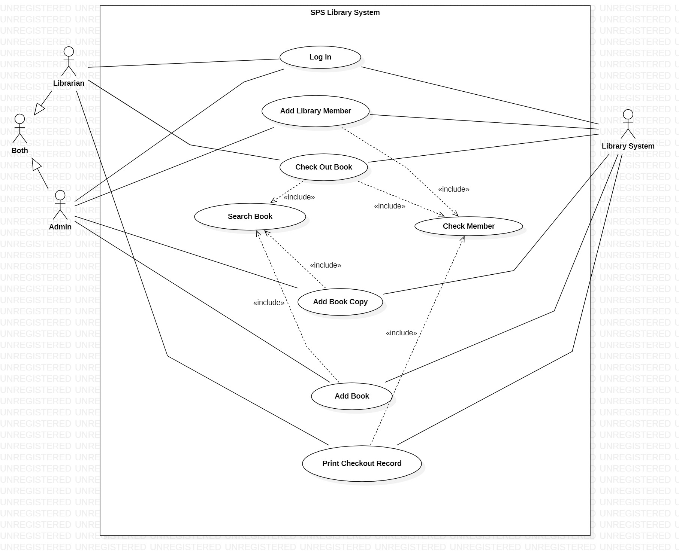
Use Cases Diagram

Slide 4
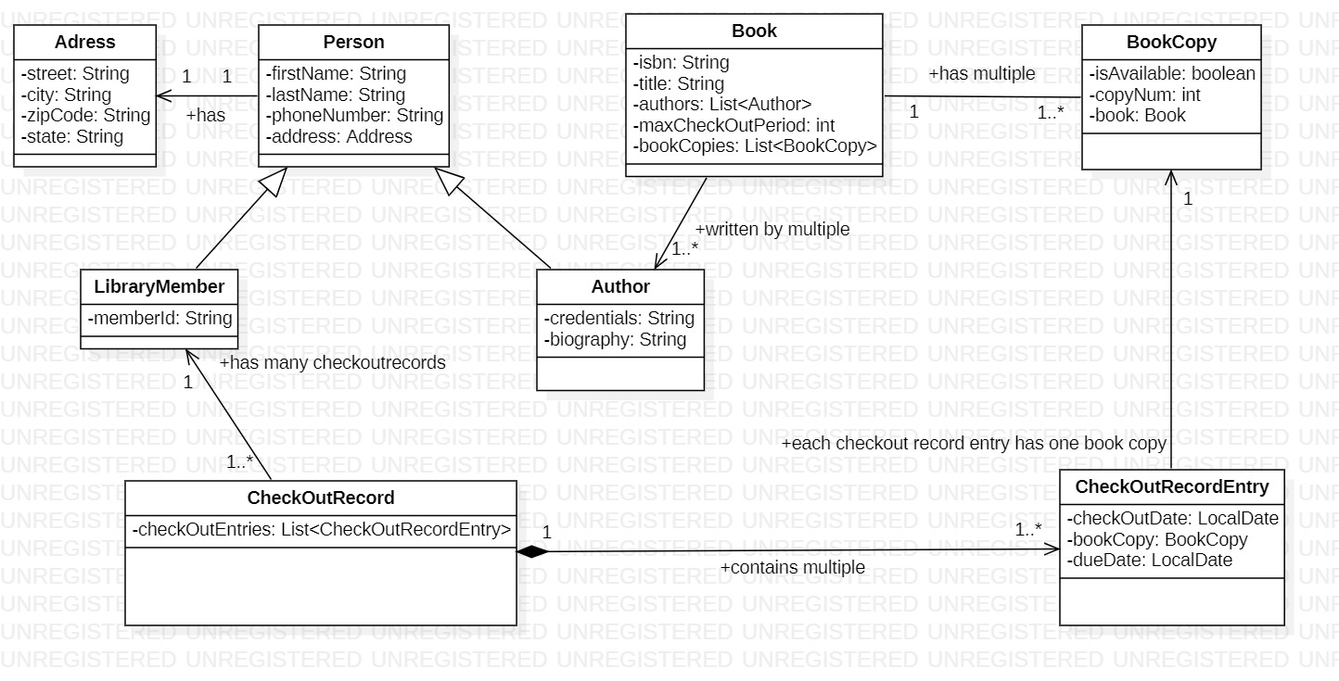
Domain Class Diagram

Slide 5
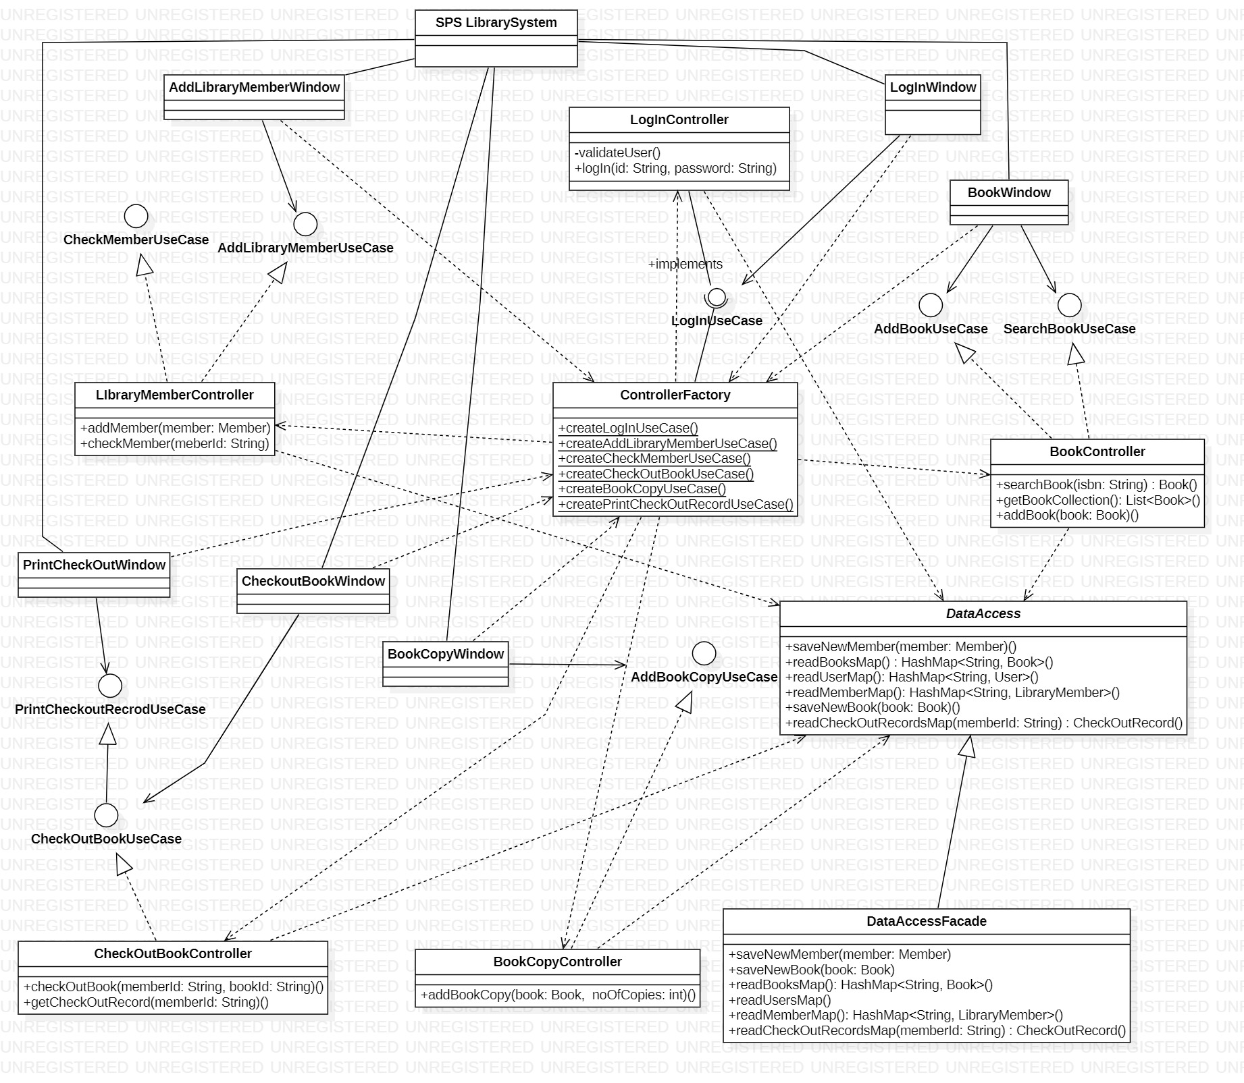
Design Class Diagram

Slide 6

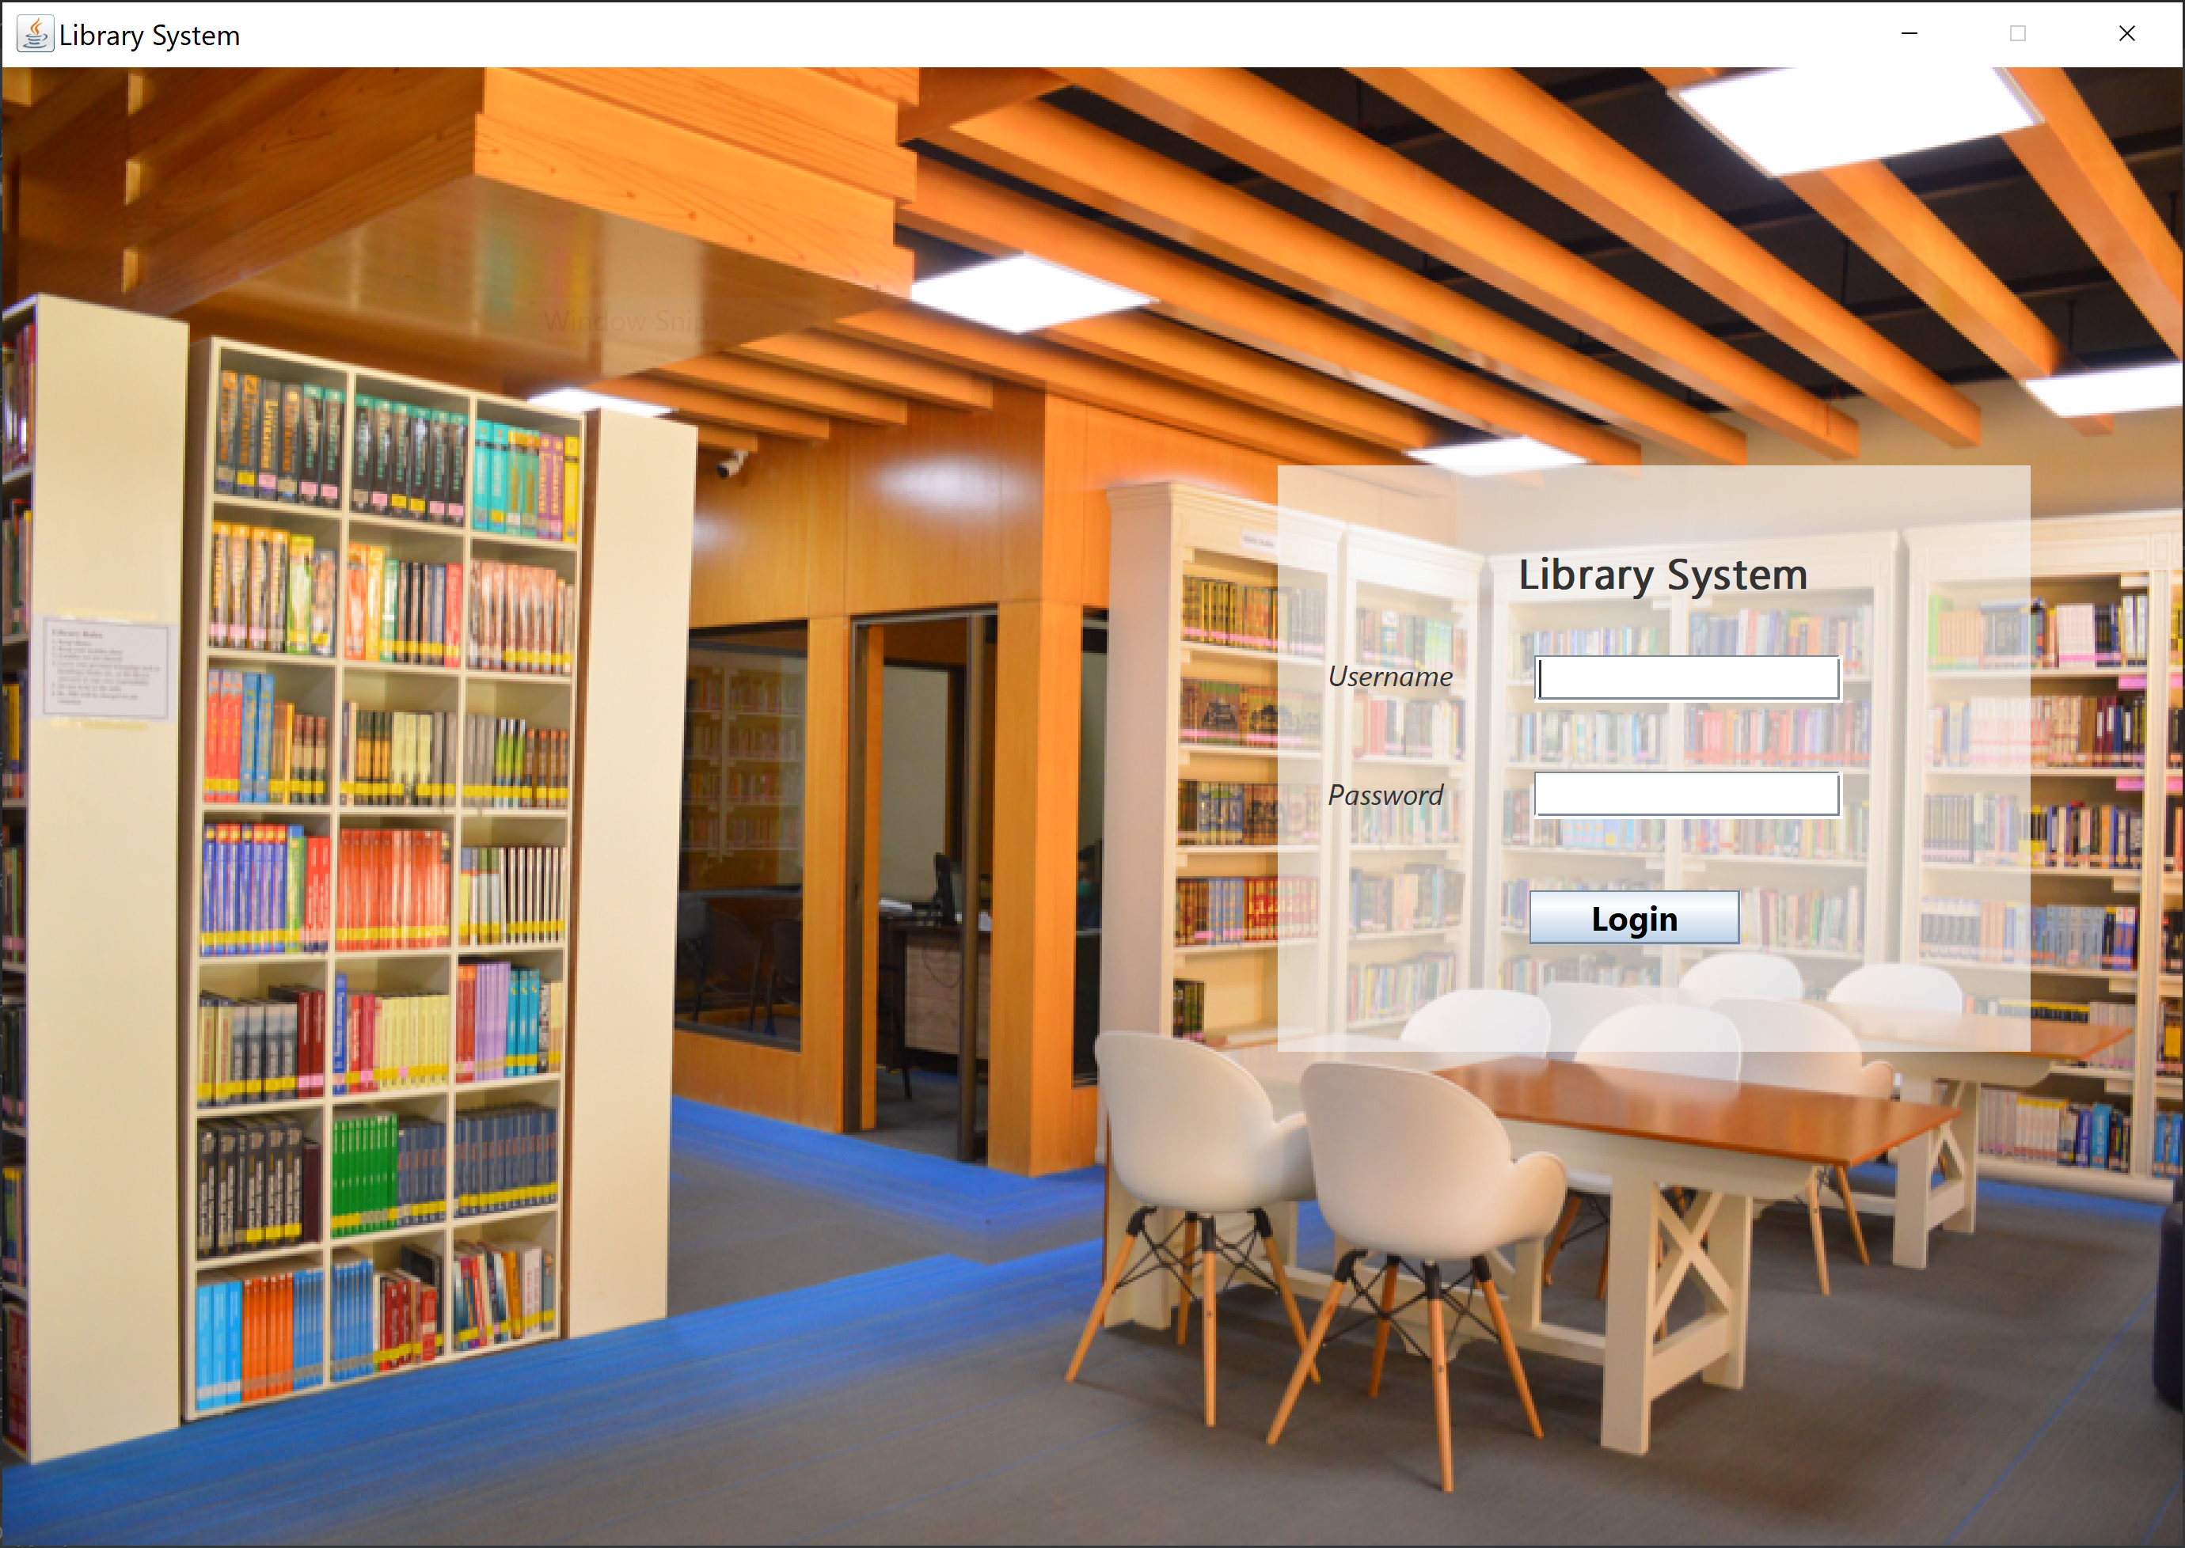
Login

Slide 7
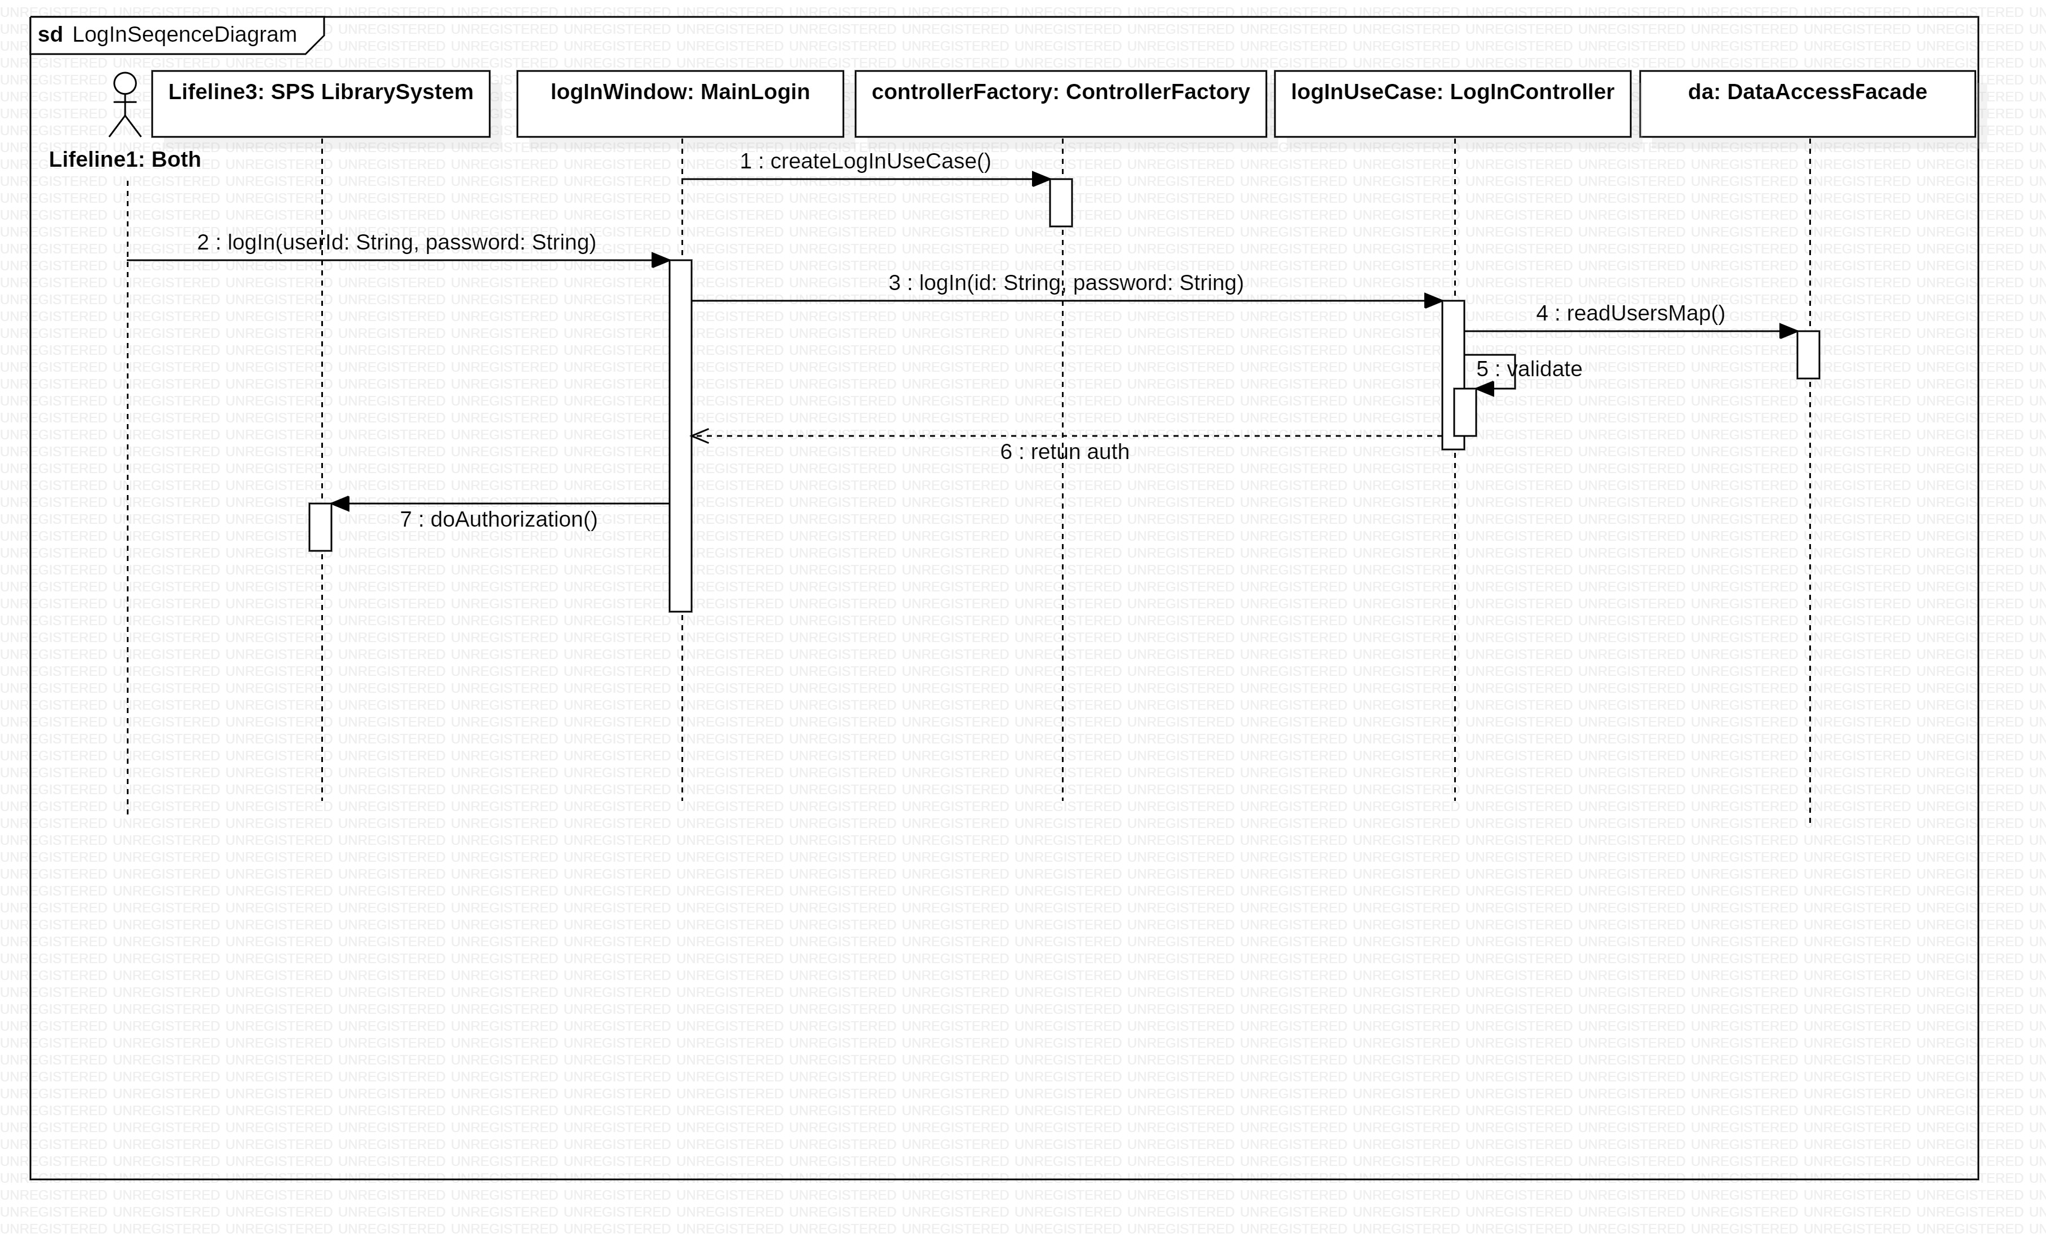
Login Sequence Diagram

Slide 8
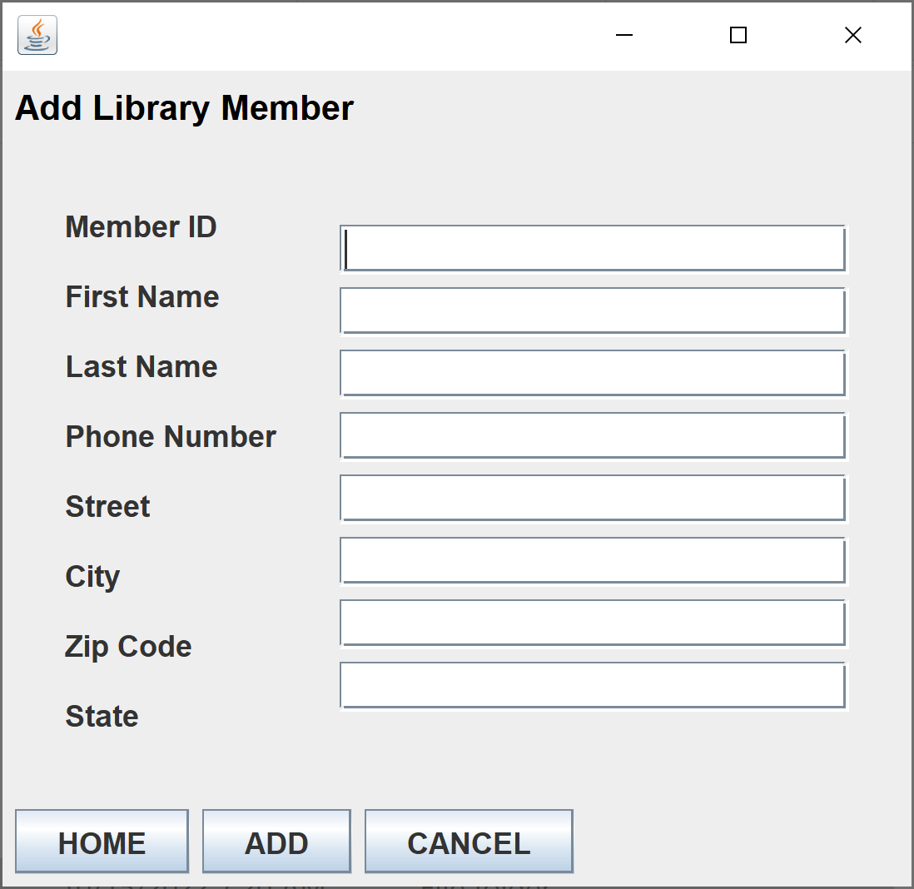
Add Library Member

Slide 9
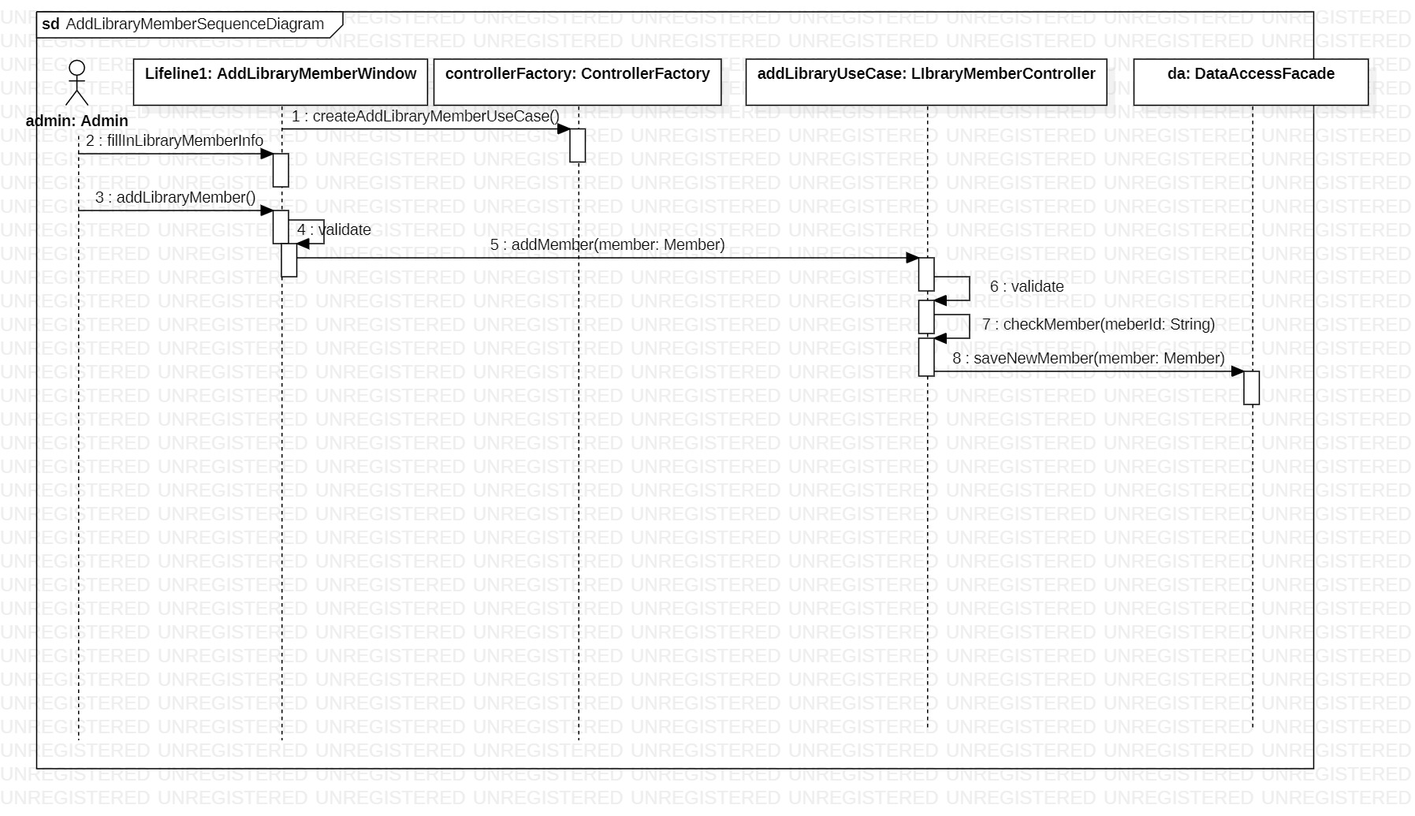
Add Library Member Sequence Diagram

Slide 10
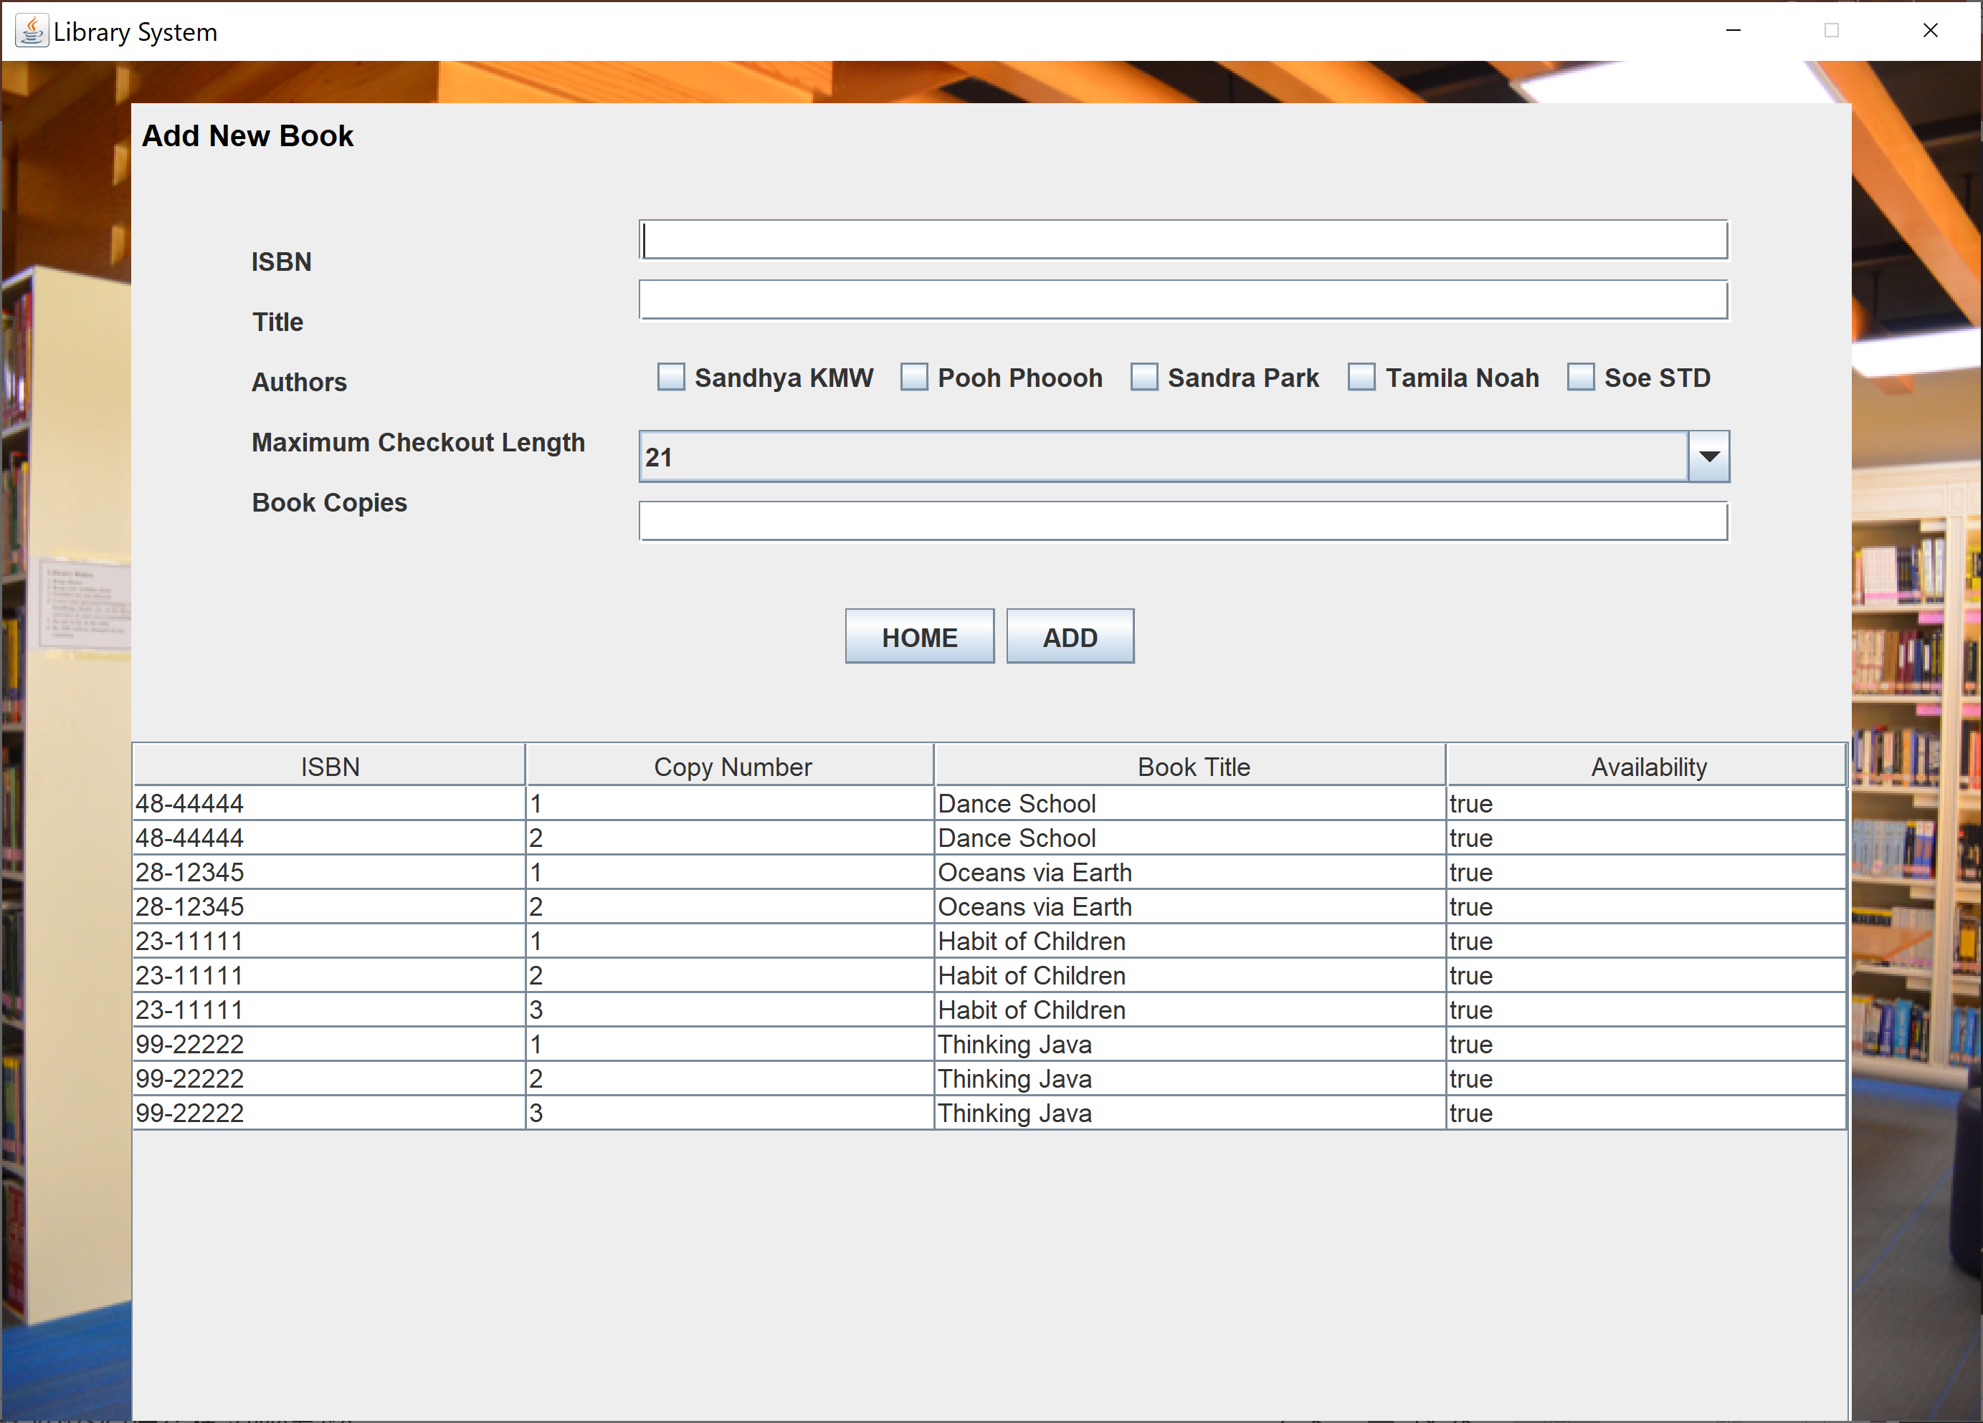
Add New Book

Slide 11
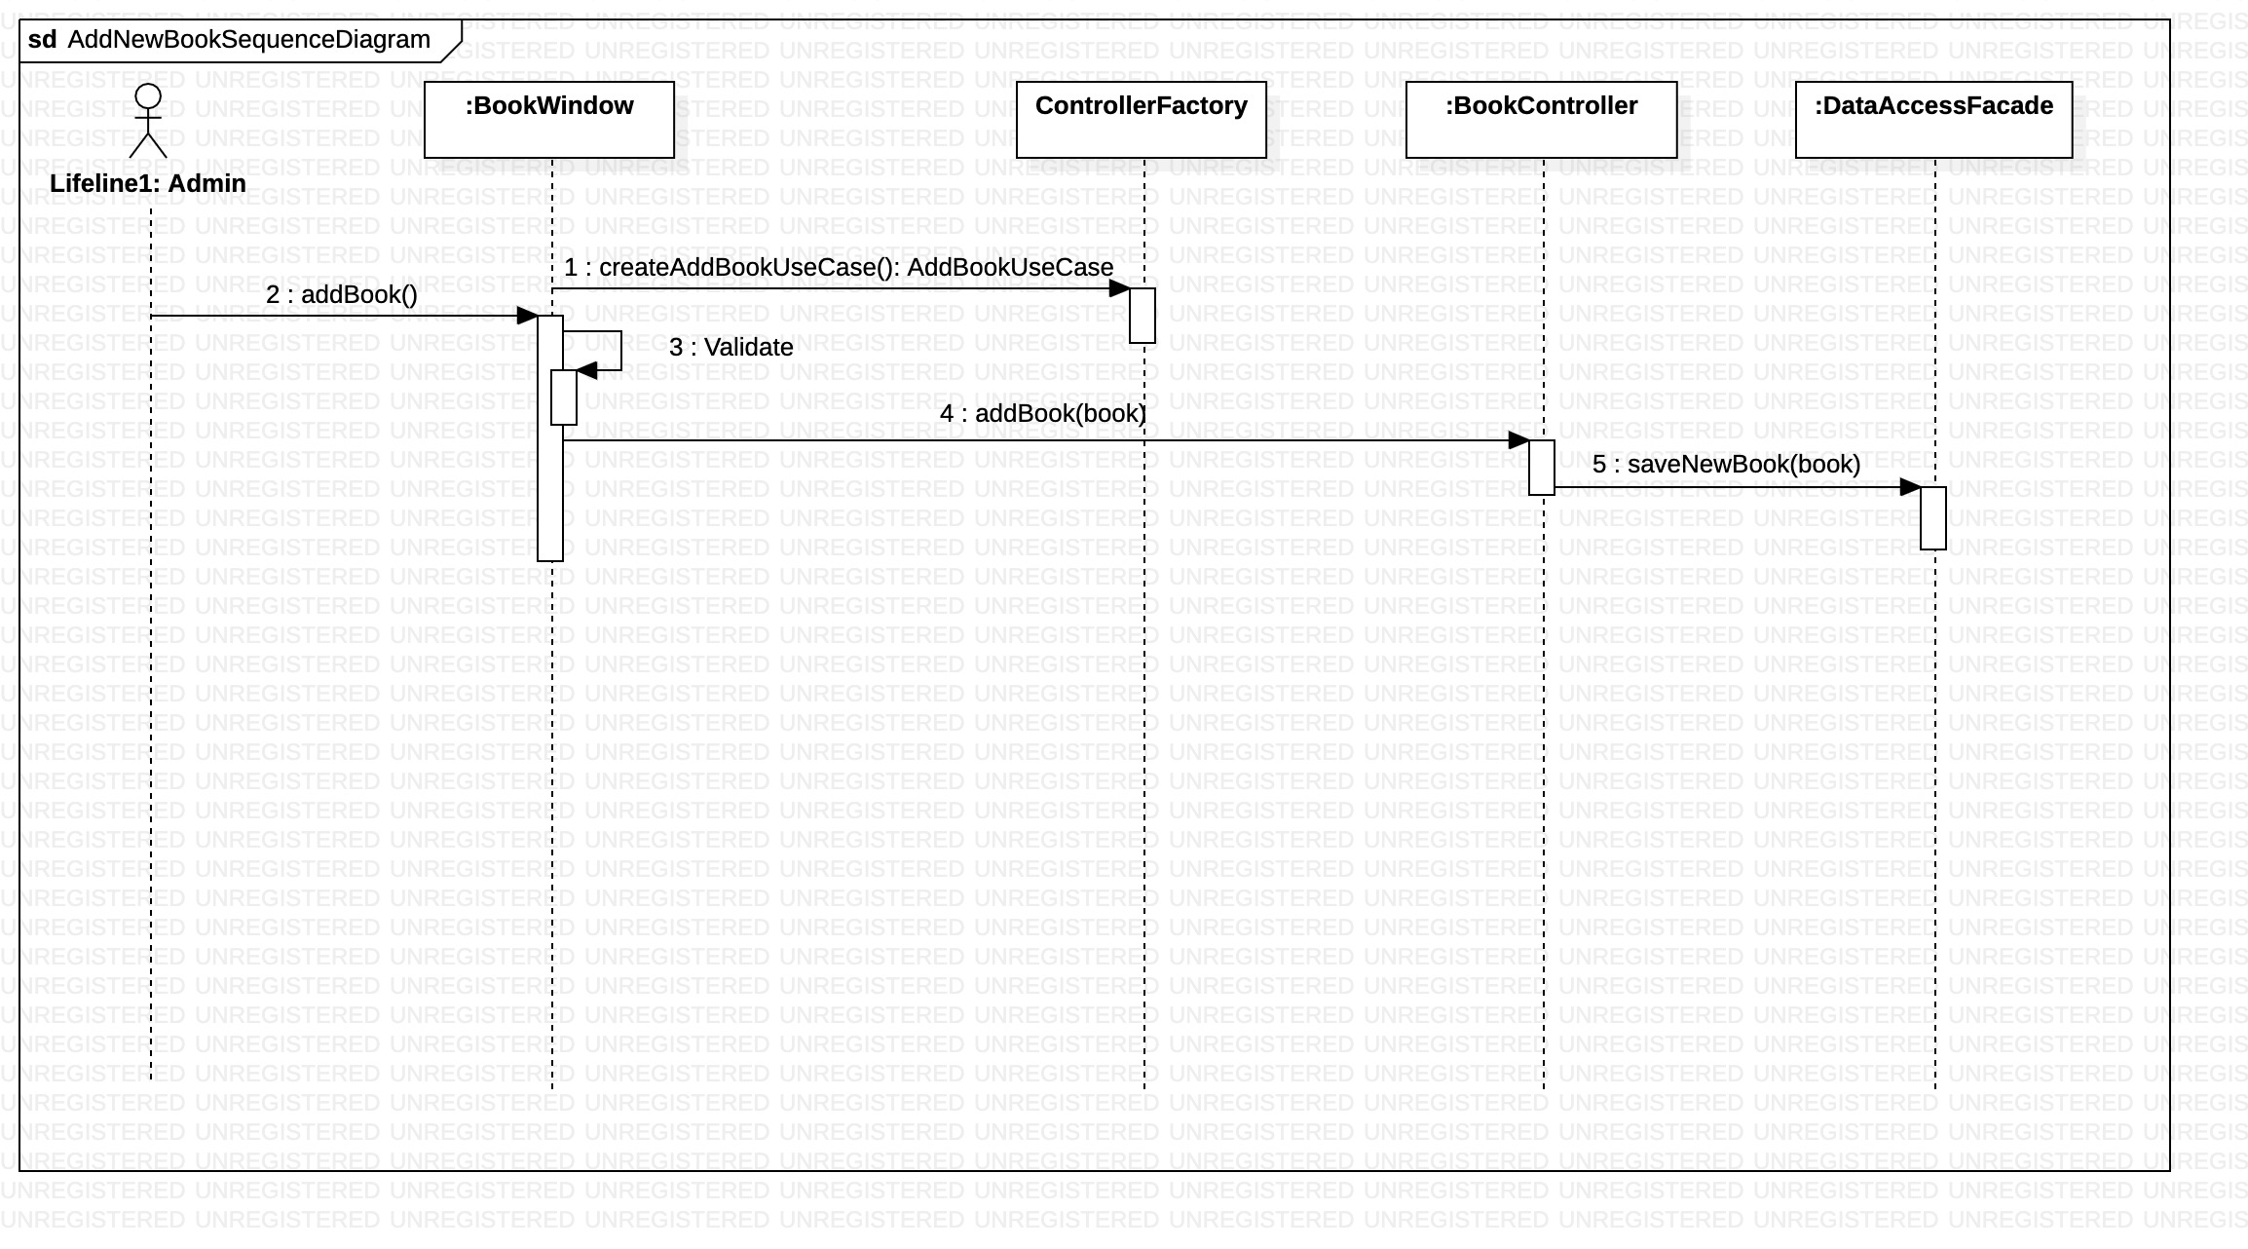
Add New Book Sequence Diagram

Slide 12
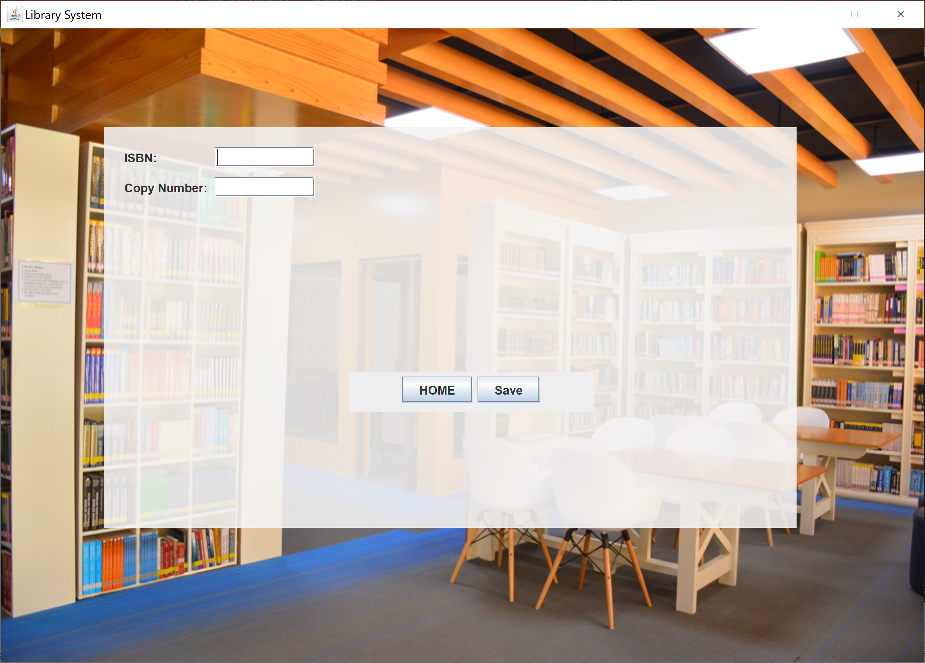
Add New Book Copy

Slide 13
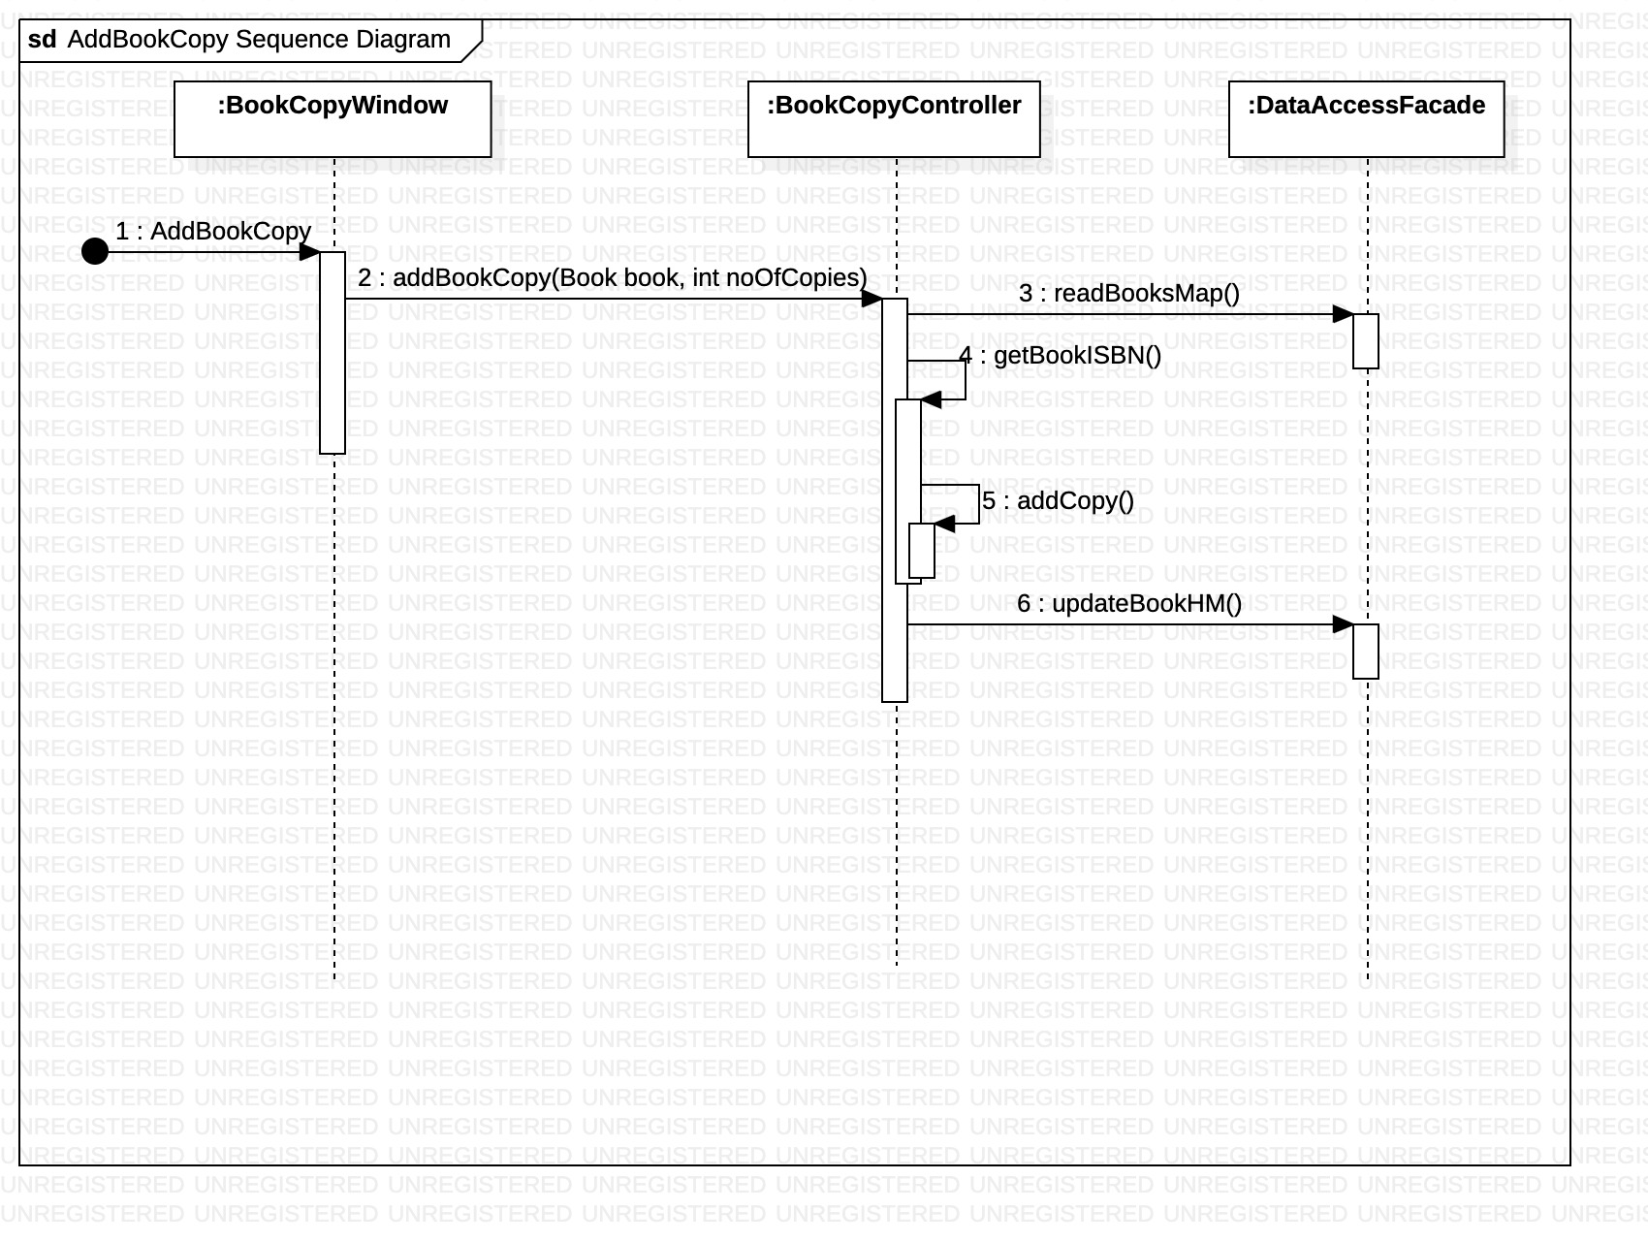
Add New Book Copy Sequence Diagram

Slide 14
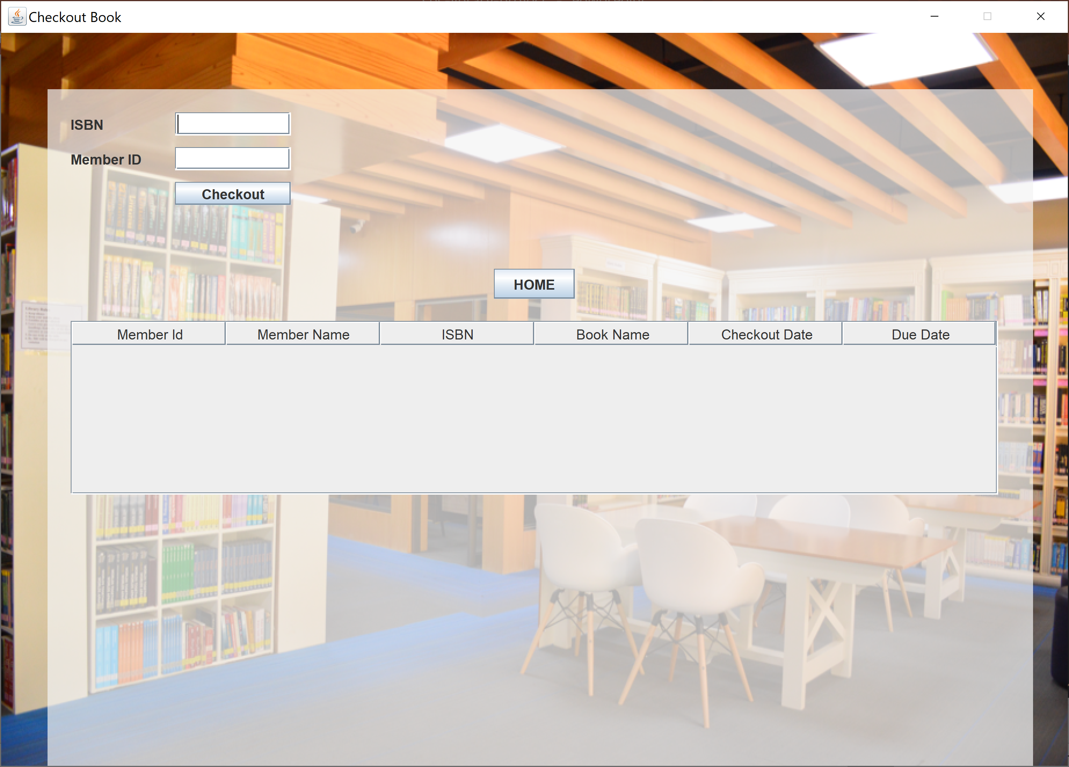
Checkout Book

Slide 15
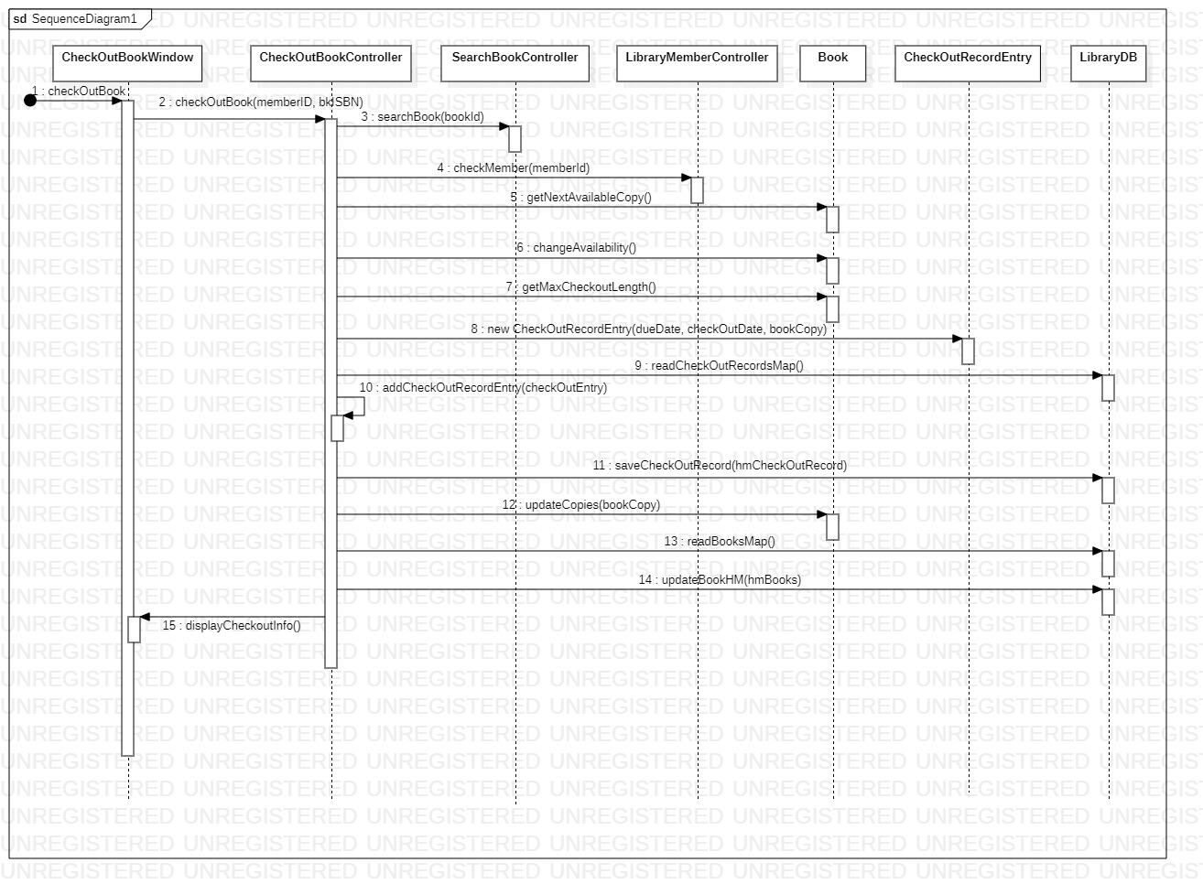
Checkout Book Sequence Diagram

Slide 16
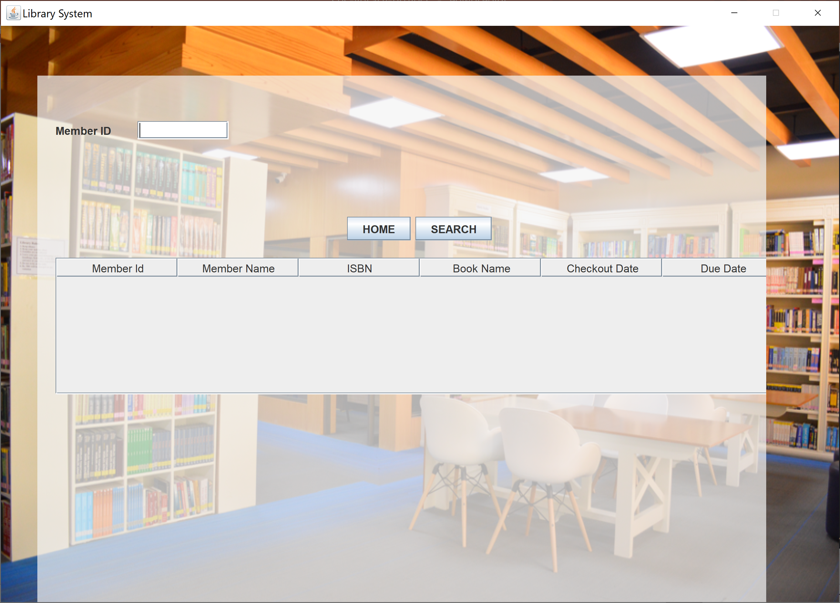
Print Checkout Record

Slide 17
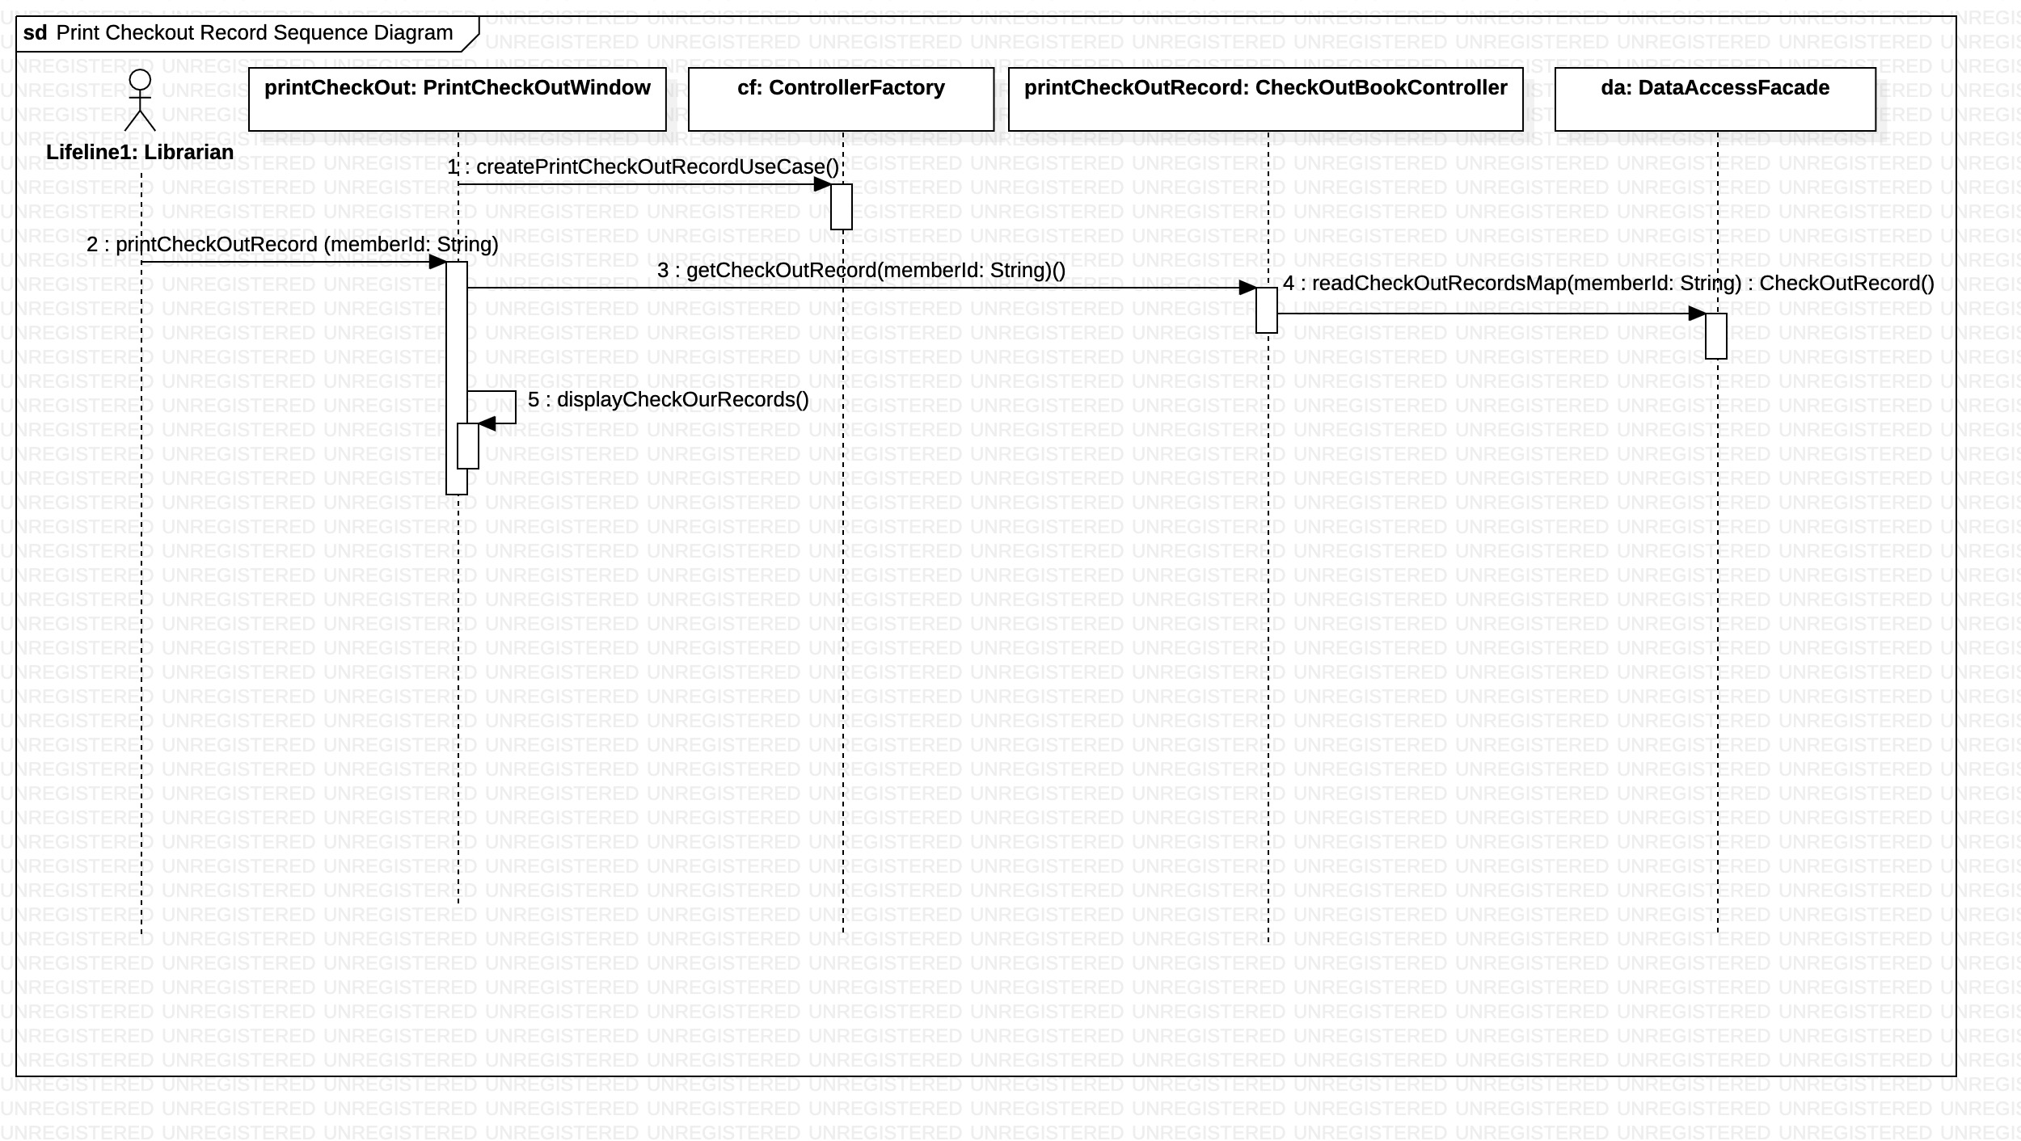
Print Checkout Record Sequence Diagram

Slide 18

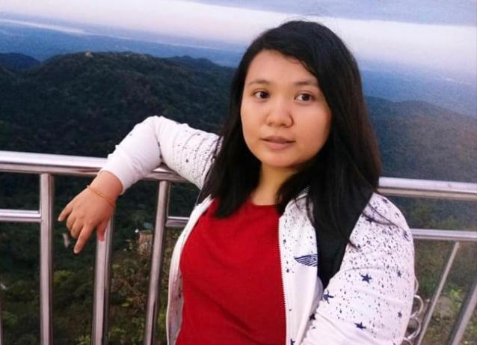

Our Team
Khin Myo Wai
Phyo Theingi
Soe Thandar

Slide 19
Thank you!

